Slide 1
Reinforcement Learning
Introduction to Deep Reinforcement Learning
Notes:
In this module we will learn about Deep Reinforcement Learning. Over the past few years, RL has become increasingly popular due to its success in addressing some of the most challenging sequential decision-making problems. Several of these achievements are due to Deep Reinforcement Learning. Researchers have shown that Deep RL agent can successfully learn from visual perceptual inputs made up of thousands of pixels (Mnih et al., 2015). This opens up the possibility to mimic some human problem solving capabilities, even in high-dimensional space — which, only a few years ago, was difficult to conceive. Several notable works using deep RL in games have stood out for attaining super-human level like in playing Atari games from the pixels (Mnih et al., 2015), mastering Go (Silver et al., 2016a) or beating the world’s top professionals at the game of Poker (Brown and Sandholm, 2017; Moravčik et al., 2017). Deep RL also has potential for real-world applications such as robotics (Levine et al., 2016; Gandhi et al., 2017; Pinto et al., 2017), self-driving cars (You et al., 2017), finance (Deng et al., 2017) and smart grids (François-Lavet, 2017), to name a few. Nonetheless, several challenges arise in applying deep RL algorithms. In this module, we will talk about those challenges and how to build Deep reinforcement learning agents.

Slide 2

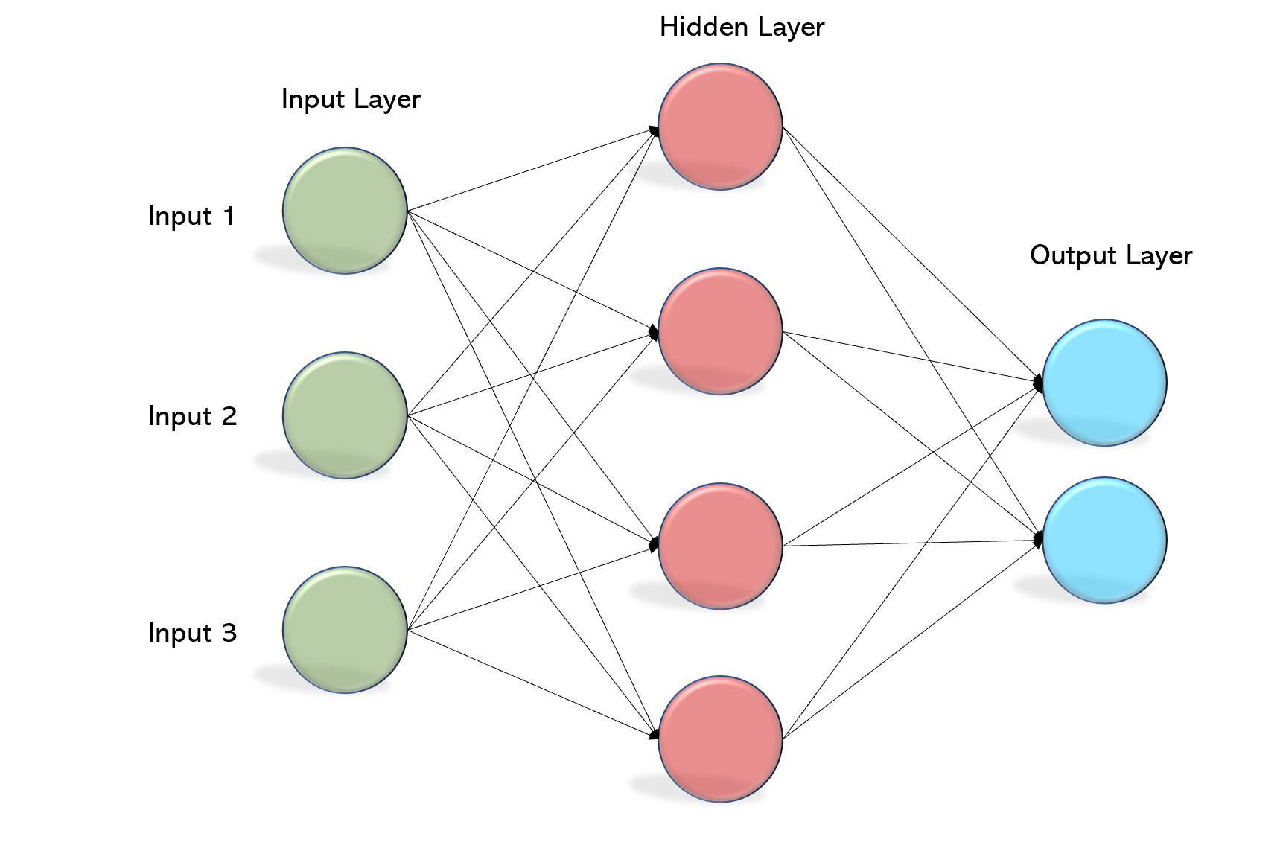
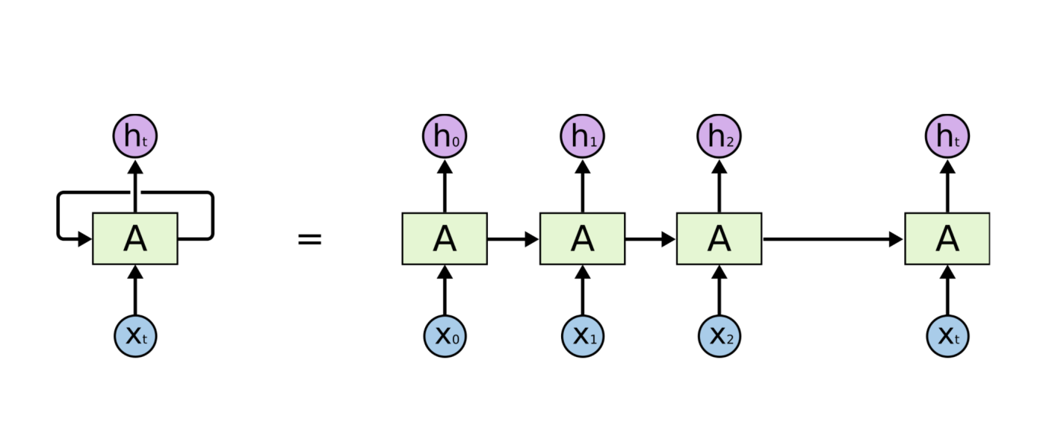
Deep Learning + RL
Notes:
Deep Reinforcement Learning – as the name suggests is the combination of Reinforcement Learning and Deep Learning. This particular combination has been proven to be useful in problems with high-dimensional space. One of the major reasons Deep RL agents work so well is because of their capability to extract good features from data, which was difficult earlier and mostly hand engineered.
The most fundamental deep learning architectures we see are –
MLP - Fully connected layers, activation functions.
CNN – Analysing visual imagery. Kernels which act as feature detectors.
RNN – Make use of sequential information and hence are widely used in NLP, speech recognition etc
What architecture to use depends on the problem we are trying to solve.
We previously discussed how we can use Neural Networks as function approximators when learning about prediction and control using approximation. However, we haven’t yet seen the implementation details yet. We will go through those in this module.

Slide 3


Deep Learning + RL
Action
 | A1 | A2 | A3
S1
S2
S3
Environment
Reward Observation

Slide 4

Deep Learning + RL
Action
Environment
Reward Observation

Slide 5

Human level control in Atari
[Reference]

Slide 6
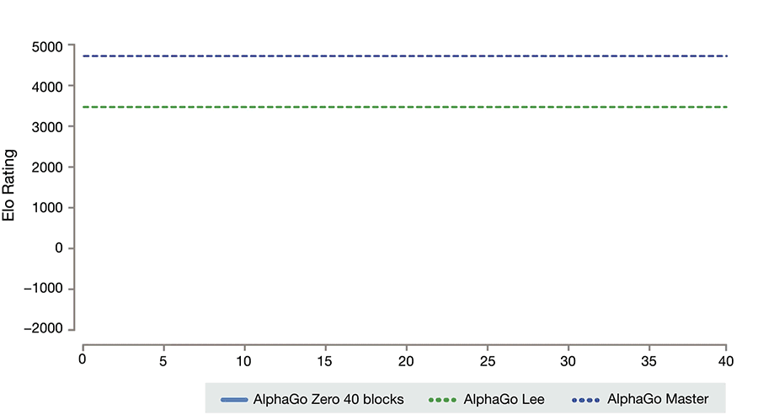
Mastering the game of Go
[Reference]
Notes:
AlphaGo is the first computer program to defeat a professional human Go player, the first to defeat a Go world champion, and is arguably the strongest Go player in history.
Go is known as the most challenging classical game for artificial intelligence because of its complexity.
Self-play
Policy gradients and model optimization – Monte Carlo Tree Search
As mentioned before, Reinforcement learning does have applications in various real world domains like robotics, self driving cars, finance etc. However we mainly talk about implementing the algorithms for various games because such games age very good examples of sequential decision making task and have simple defined rewards and hence they are good to quickly check the performance of the algorithm.

Slide 7
Reinforcement Learning
Deep Q-Learning

Slide 8
Deep Q-Learning
 | A1 | A2 | A3
S1
S2
S3
State
Q-value
Action
Q-value Action 1
Q-value Action 2
State
Q-value Action 3
Q-value Action 4

Slide 9

Deep Q-Network
Q-value Action 1
Pre-processed pixels
Q-value Action 2
Q-value Action 3
Q-value Action 4

Slide 10
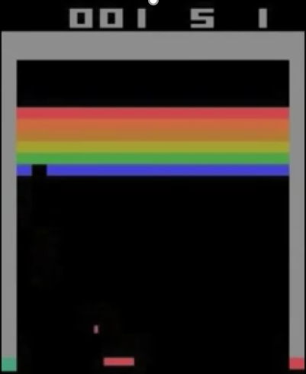
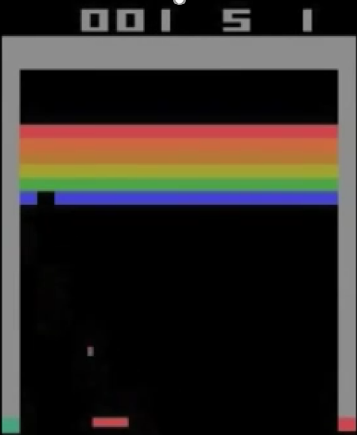
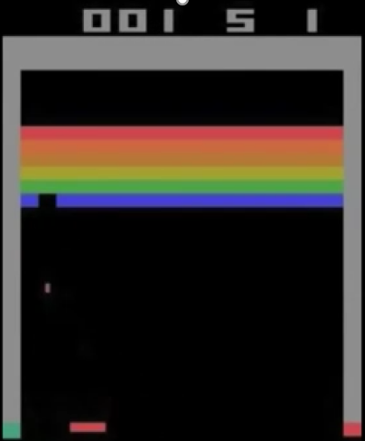
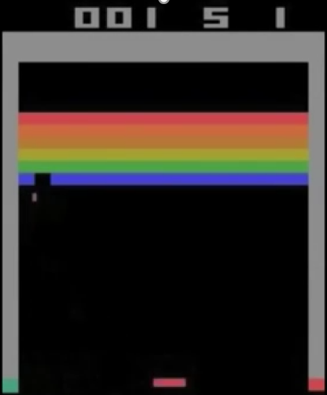
Pre-processing input for DQN
160
84
84
4
84
84
210

Slide 11
CNN Architecture
84
4
84
Relu
Relu
Relu
84x84x4 sized input
Conv2D 32 8x8 filters(stride=4)
Conv2D 16 4x4 filters(stride=2)
256 units FC
n_action units FC

Slide 12
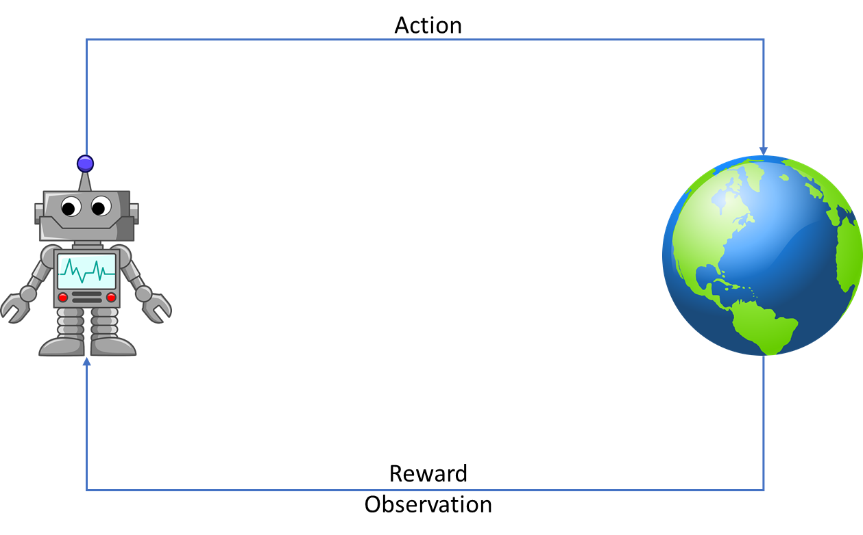
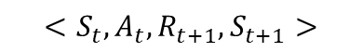
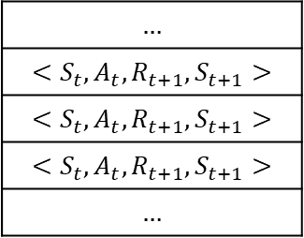
Experience Replay
Learning
Learning
$$…$$
$$<S_{t},A_{t},R_{t+1},S_{t+1}>$$
$$<S_{t},A_{t},R_{t+1},S_{t+1}>$$
$$<S_{t},A_{t},R_{t+1},S_{t+1}>$$
$$…$$
$$<S_{t},A_{t},R_{t+1},S_{t+1}>$$
Acting
Acting

Slide 13
Advantages of Experience Replay
Can use same experience tuple multiple times and hence better use of experience.
Random sampling from the replay buffer breaks correlation between sequential experiences.

Slide 14
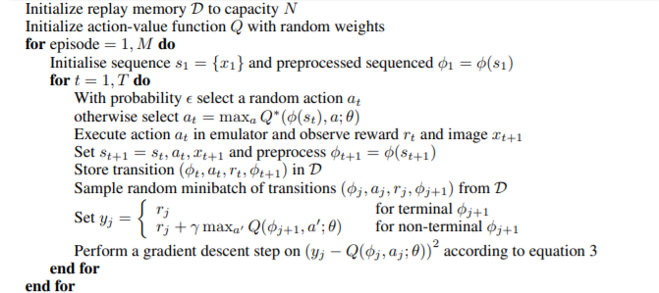
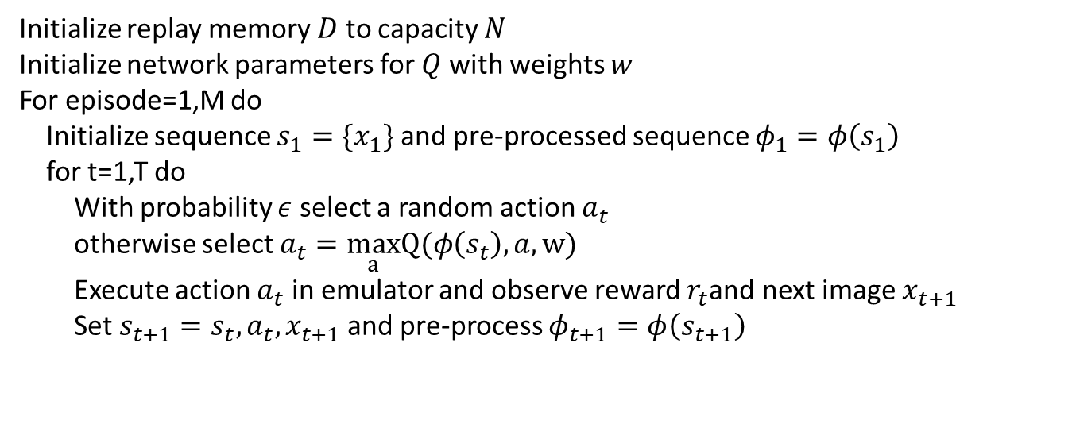
DQN with Experience Replay
[Reference]
Initialize replay memory $D$ to capacity $N$
Initialize network parameters for $Q$ with weights $w$
For episode=1,M do
Initialize sequence $s_{1}=\{x_{1}\}$ and pre-processed sequence $φ_{1}=φ\left(s_{1}\right)$
for t=1,T do
With probability $ε$ select a random action $a_{t}$
otherwise select $a_{t}=\max_{a}Q(φ\left(s_{t}\right),a,w)$
Execute action $a_{t}$ in emulator and observe reward $r_{t}$and next image $x_{t+1}$
Set $s_{t+1}=s_{t}, a_{t}, x_{t+1}$and pre-process $φ_{t+1}=φ\left(s_{t+1}\right)$

Slide 15
Reinforcement Learning
Fixed Targets

Slide 16

Problem of Moving Target
$$q_{π}\left(S_{t},A_{t}\right)$$
$$w_{t+1}=w_{t}+α[R_{t+1}+γ\max_{a}{\hat{q}\left(S_{t+1},a,w_{t}\right)−\hat{q}\left(S_{t},A_{t},w_{t}\right)]∇\hat{q}\left(S_{t},A_{t},w_{t}\right)}$$

Slide 17
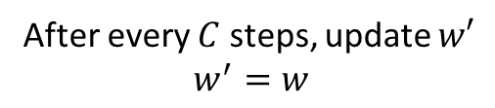
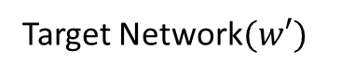
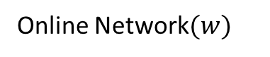
Target Network
$$w_{t+1}=w_{t}+α[R_{t+1}+γ\max_{a}{\hat{q}\left(S_{t+1},a,w′ \right)−\hat{q}\left(S_{t},A_{t},w_{t}\right)]∇\hat{q}\left(S_{t},A_{t},w_{t}\right)}$$
Online Network$(w)$
After every $C$ steps, update $w′$
$$w^{′}=w$$
Target Network$(w′)$

Slide 18
Reinforcement Learning
Double Q-Learning

Slide 19
Maximization Bias
$$w_{t+1}=w_{t}+α[R_{t+1}+γ\max_{a}{\hat{q}\left(S_{t+1},a,w_{t}\right)−\hat{q}\left(S_{t},A_{t},w_{t}\right)]∇\hat{q}\left(S_{t},A_{t},w_{t}\right)}$$

Slide 20
Double Q-Learning
$w_{t+1}=w_{t}+α[R_{t+1}+γ\hat{q}\left(S_{t+1},argmax_{a}\hat{q}\left(S_{t+1},a,w\right),w^{−}\right)−\hat{q}\left(S_{t},A_{t},w_{t}\right)$] $∇\hat{q}\left(S_{t},A_{t},w_{t}\right)$

Slide 21
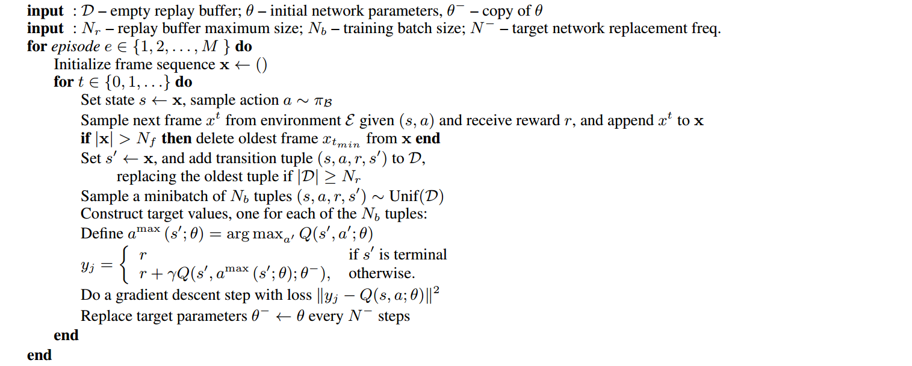
Double DQN Algorithm
[Reference-1]
[Reference-2]

Slide 22
Reinforcement Learning
Dueling Network

Slide 23
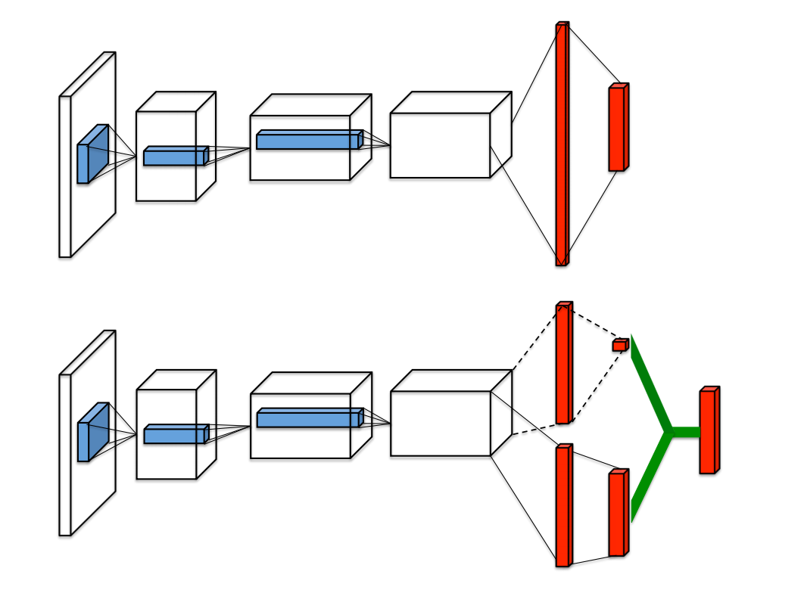
Dueling Network Architecture

Slide 24
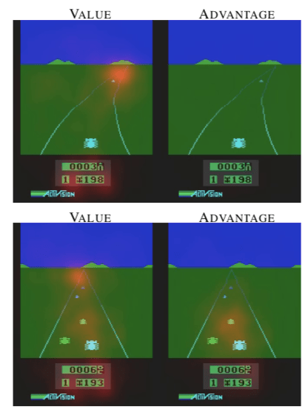
Advantage Function and Value Function

Slide 25
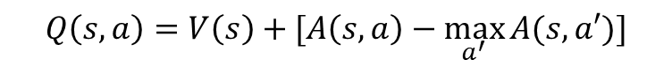
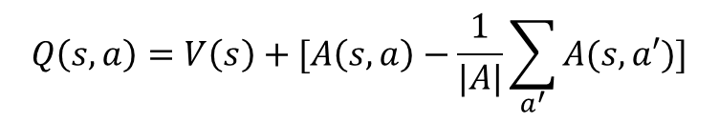
Aggregation Layer
$$Q\left(s,a\right)=V\left(s\right)+[A\left(s,a\right)−\max_{a^{′}}{A(s,a′)]}$$
$$Q\left(s,a\right)=V\left(s\right)+[A\left(s,a\right)−\frac{1}{|A|}\sum_{a^{′}}{A(s,a′)}{]}$$
[Reference-1]

